Slide 1

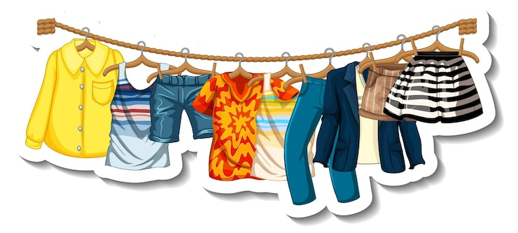
Baju dan warna
BIPA 2

Slide 2
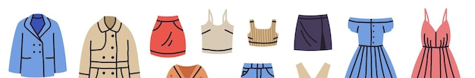
Kosakata Pakaian (clothes)
Kaos | T shirt
Kemeja | shirt
Celana Panjang | Pants
Celana pendek | Short pants
Jas hujan | Raincoat

Slide 3

Kosakata Warna
Perak | Silver | Sawo matang | Tan colour
Biru | Blue | Merah muda | Pink
Merah | Red | Hijau | Green
Kuning | Yellow | Putih | White
Hitam | Black | Abu-abu | Grey
Coklat | brown | Jingga / oranye | Orange
Krim | Cream | Ungu | Purple

Slide 4
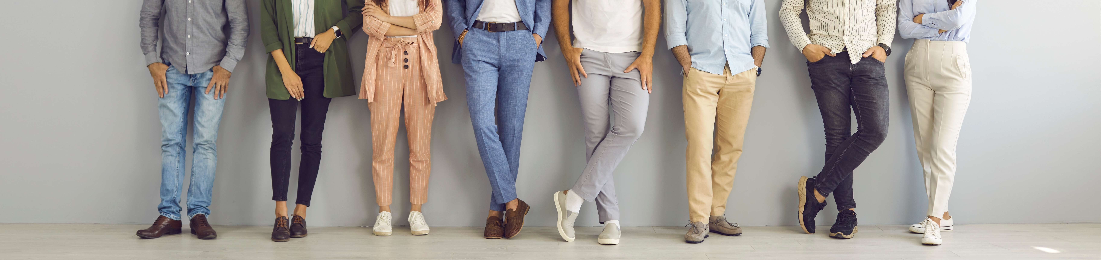
Apa pakaian favoritmu?
Warna apa?
Untuk acara apa?
Pakaian favoritku adalah jas, jas warna coklat, untuk acara kerja
Praktik Bicara

Slide 5
Indonesia | English | Konteks Komplain/Fitting (Indonesia) | Arti Kalimat (English Meaning)
Bahu | Shoulder | "Kemejanya sempit di bahu." | "The shirt is tight in the shoulders."
Dada | Chest | "Lingkar dadanya kurang lebar." | "The chest width is not wide enough."
Perut | Stomach | "Agak sesak di perut (kekecilan)." | "It's a bit tight/squeezed around the stomach (too small)."
Pinggang | Waist | "Celananya longgar di pinggang." | "The pants are loose at the waist."
Paha | Thigh | "Sempit di paha, susah duduk." | "It's tight in the thighs, it's hard to sit down."
Kaki | Foot | "Ujung kaki sakit, sepatunya kekecilan." | "My toes hurt, the shoes are too small."

Slide 6
Kata (Indonesia) | Arti (English) | Context of Use (English Only) | Contoh Kalimat (Example)
Sempit | Tight / Narrow | Used when clothes restrict movement or press against the skin (shoulders, thighs). | "Kemejanya sempit di bahu, saya susah gerak."
Sesak | Tight / Suffocating | Used when clothes constrict breathing or feel heavy on the chest/stomach. | "Kancingnya sesak di leher."
Longgar | Loose / Baggy | Used when there is too much empty space; requires a belt or resizing. | "Celana ini longgar banget di pinggang."
Kekecilan | Too Small | General size issue (e.g., wearing S when you are L). | "Sepatunya kekecilan, jari saya sakit."
Kebesaran | Too Big | General size issue (e.g., wearing XL when you are M). | "Jas ini kebesaran, saya kelihatan tenggelam."
Kepanjangan | Too Long | Sleeves covering hands or pants dragging on the floor. | "Lengan kemejanya kepanjangan, perlu dipotong."
Kependekan | Too Short | Pants ending above ankles or shirt ending above the belly button. | "Celananya kependekan, kayak celana banjir."
Tulis 5 kalimat dengan ini!

Slide 7
Kata | English Description | (Kalimat Contoh)
Sekitar | Means around / approximately. Used before numbers or measurements to show an estimated amount. | Harganya sekitar 500 ribu
Kira-kira | Similar to about / roughly. Used for guessing or giving an uncertain number or time. | Harga sepatu itu kira-kira dua ratus ribu rupiah.
Kisaran | Means range / scope. Used as a noun to show a range of values or amounts. | Ukurannya kisaran XL atau XXL
Kurang lebih | Means more or less / approximately. Often used in formal or polite situations. | Tingginya kurang lebih 190 cm.
Hampir | Means almost / nearly. Used to describe something close to a certain number, measurement, or limit. | Tinggi badan Sebastian hampir dua meter.
Pas | Fits perfectly / Exact | ukuran sepatunya pas!
Tulis 5 kalimat dengan ukuran!

Slide 8
Baju
Kemeja
Celana
Jaket
Sepatu
Kaos
Jas
Sarung
Sempit
Sesak
Longgar
Kekecilan
Kebesaran
Kepanjangan
Kependekan
Pas
Bahu
Dada
Perut
Pinggang
Paha
Kaki
Di sebelah /
bagian
Nya / ini

Slide 9
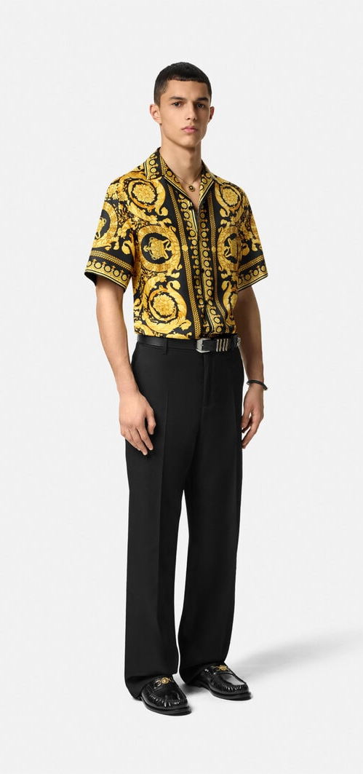
Baca teks di Microsoft word
Praktik Bicara

Slide 10
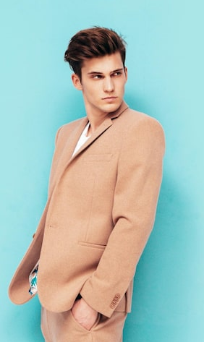
Bahasa Indonesia | Bahasa Inggris
Kemeja | Shirt
Kaus | T-shirt
Gaun | Dress
Blus | Blouse
Jaket | Jacket
Hoodie | Hoodie
Baju hangat | Sweater / Jumper
Rompi | Vest
Dasi | Tie

Slide 11
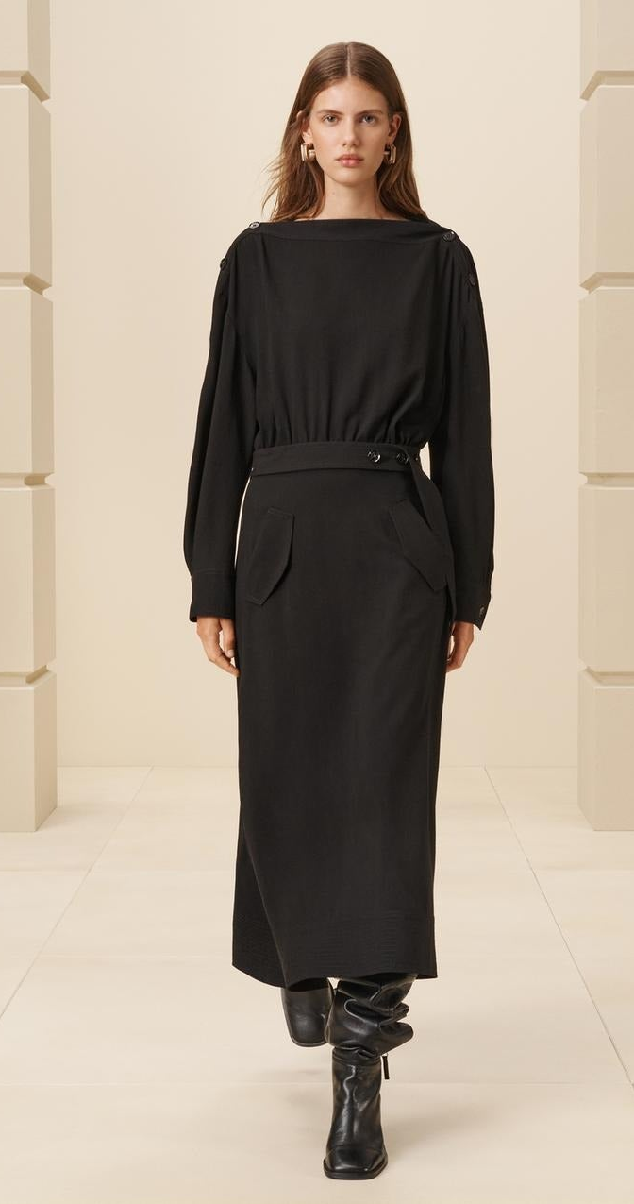
Bahasa Indonesia | Bahasa Inggris
Celana panjang | Pants / Trousers
Celana pendek | Shorts
Rok | Skirt
Celana ketat | Tights
Sepatu | Shoes
Sandal | Sandals
Sepatu bot | Boots
Sandal | Flip-flops / Slippers
Kaus kaki | Socks

Slide 12
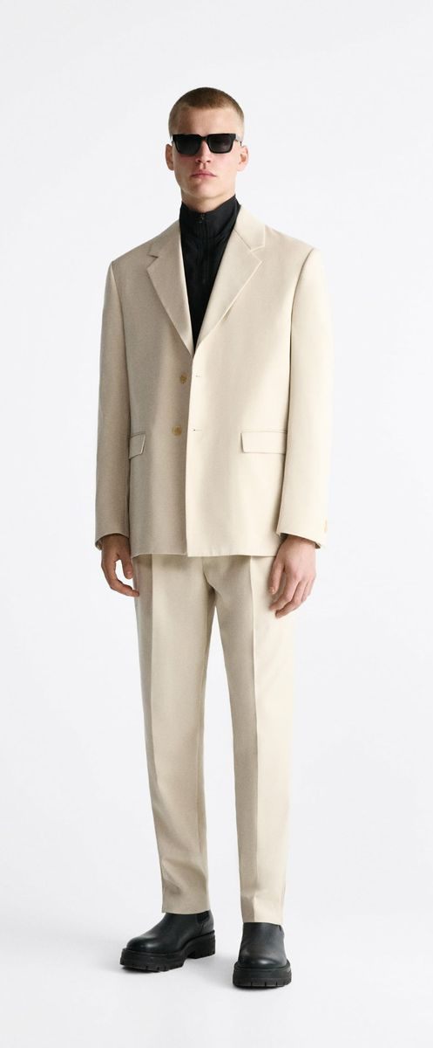
Mantel | Coat
Jas hujan | Raincoat / Trench coat
Topi | Hat
Syal | Scarf
Sarung tangan | Gloves
Ikat pinggang | Belt
Kacamata | Glasses
Kacamata hitam | Sunglasses
Jam tangan | Wristwatch

Slide 13
Saya punya baju kemeja dan celana panjang favorit.
Merek bajunya Versace.
Warnanya kuning dan celananya hitam.
Ukuran bajunya M, dan ukuran celananya 32.
Saya biasa pakai baju ini saat pergi ke pesta.
Harganya sekitar 350 ribu rupiah.
Saya beli baju dan celana ini di toko Versace Surabaya.

Slide 14
Praktik Bicara
Jelaskan pakaian favorit :
(baju, celana dan sepatu)
- merek (brand)
Warna
Ukuran
Harga
Beli dimana
Untuk acara apa

Slide 15
